Slide 1
Quantum state reduction -
Quantum Mechanics meets General Relativity in Nanoscale Experiments
Tjerk Oosterkamp
Kamerlingh Onnes Lab, Leiden
Vancouver, May 24th 2013
Notes:
Bob z’n data en experiment

Slide 2
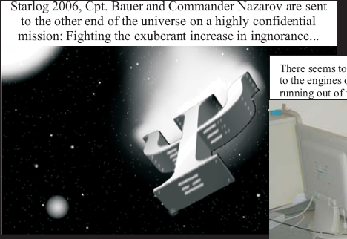
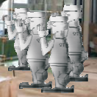

Slide 3
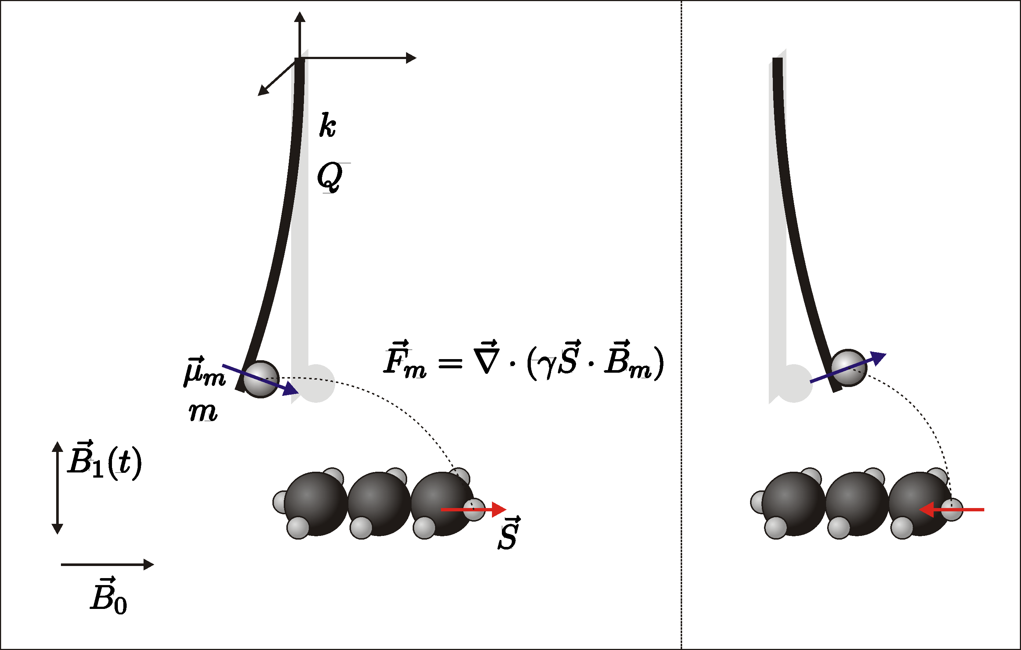
The blind microscope
MRI at the nanoscale
Tjerk Oosterkamp
Universiteit Leiden, Natuurkunde
1/10

Slide 4
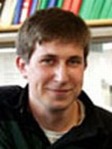
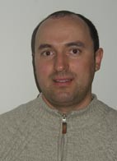
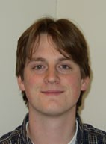
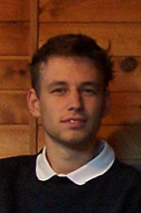
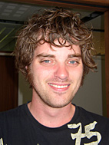
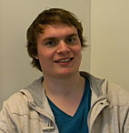
MRI at the nanoscale
Sasha Andrea Geert Arthur Bob van Marc
Usenko Vinante Wijts den Haan Waarde de Voogd

Slide 5
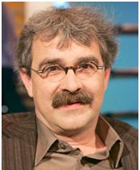
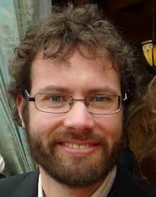
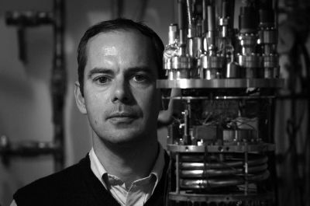
Quantum state reduction
Jan Jasper Dirk Bob van Marc
Zaanen van Wezel Bouwmeester Waarde de Voogd

Slide 6
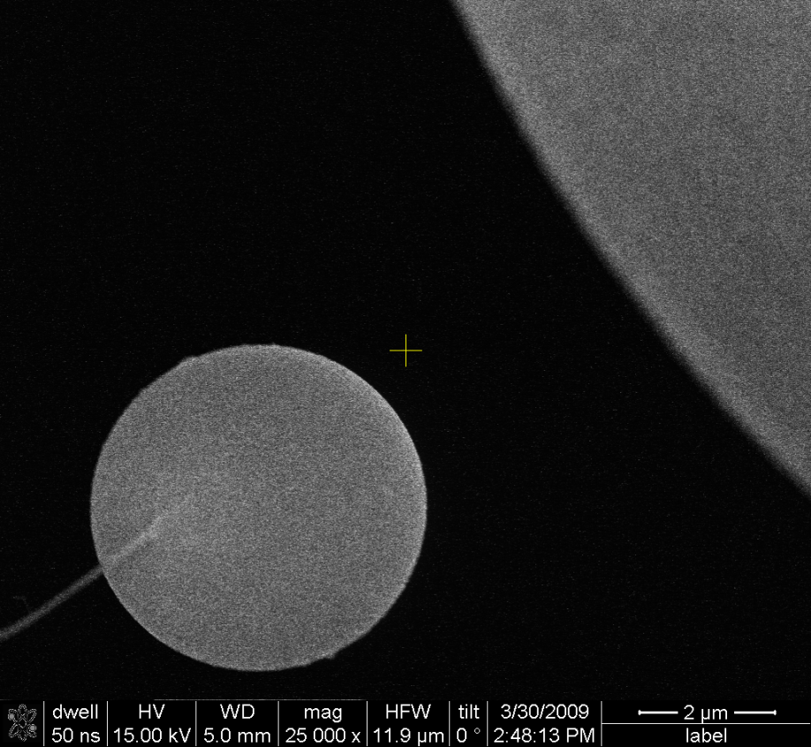
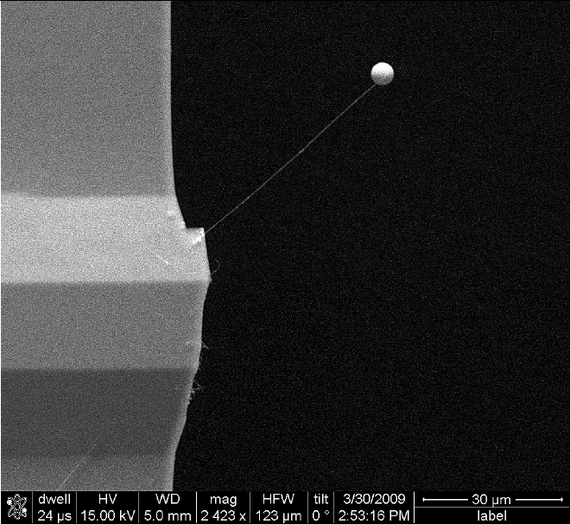
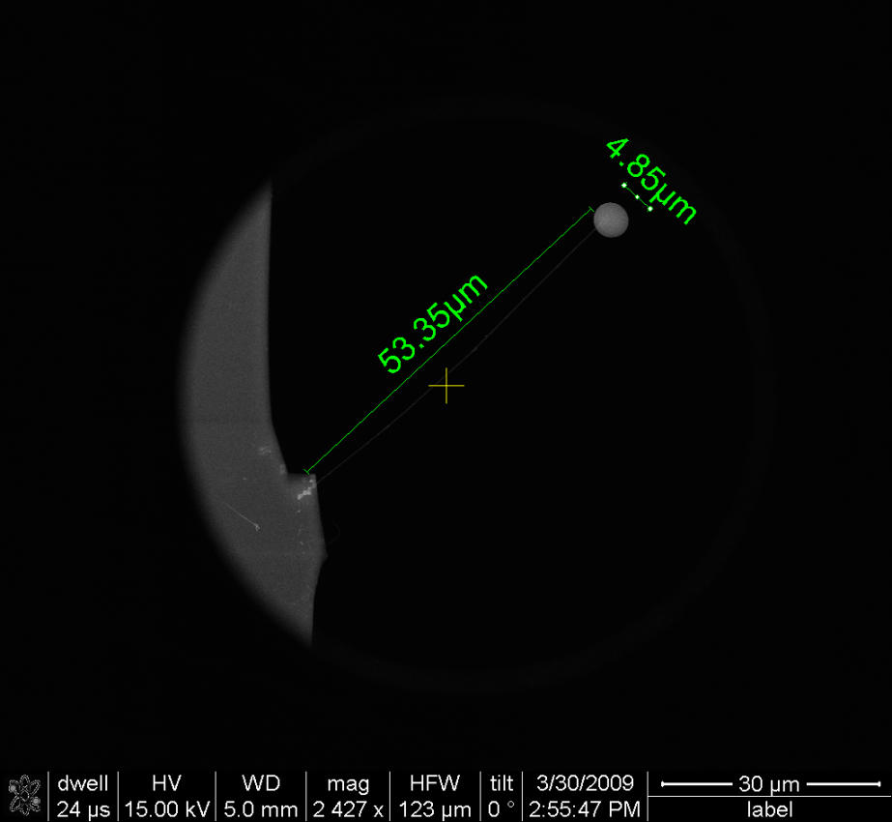
where I’m coming from: three experiments
Magnetic Resonance Force Microscopy
Cooling the force sensor
Levitated superconductor

Slide 7
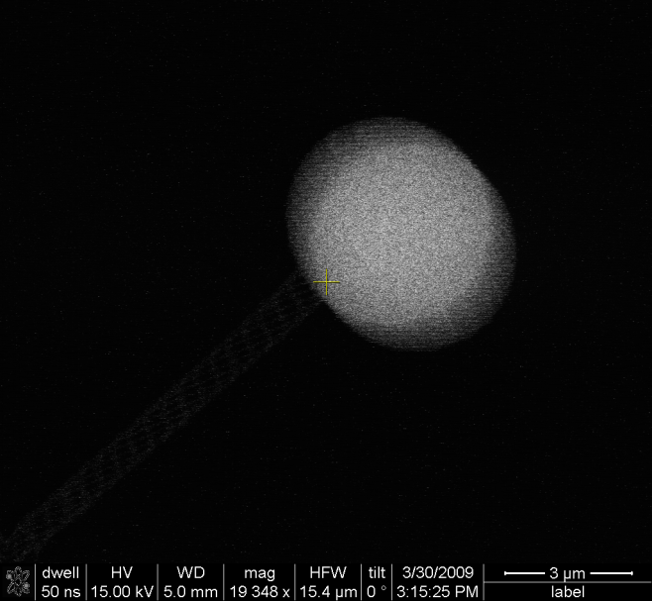
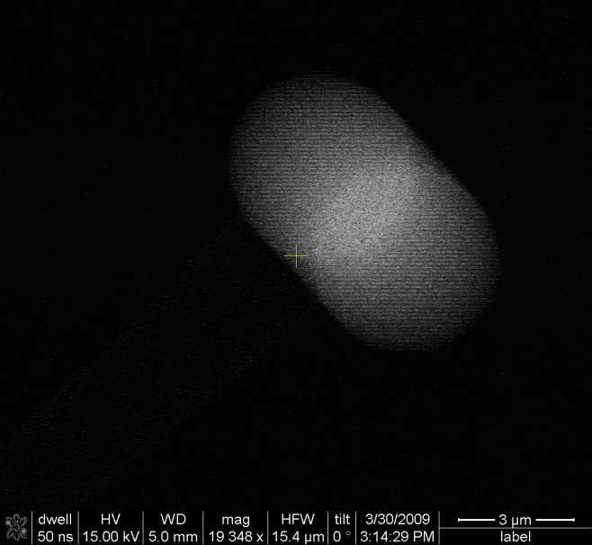
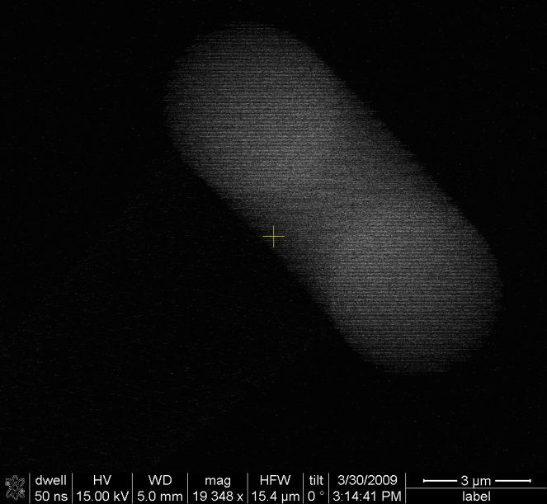
Resonance of Cantilever at RT
In the SEM a resonance is measured at 1472 Hz with Q of 2300 (by applying 1V DC and 10 mV ac)

Slide 8
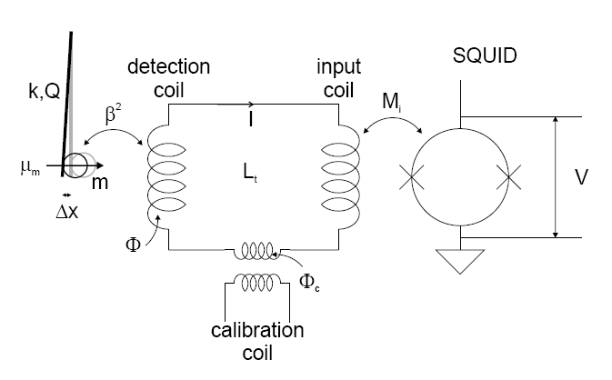

Slide 9
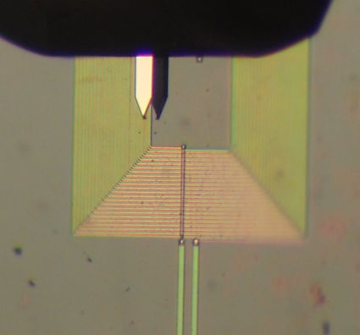
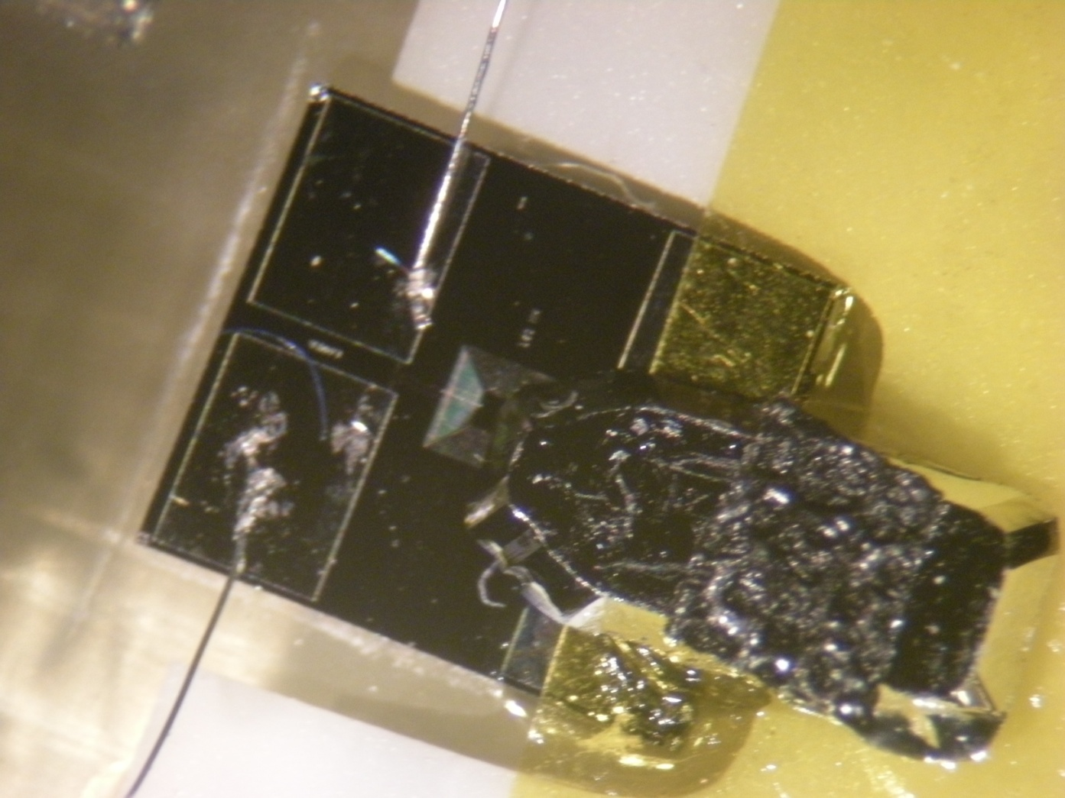
Nanowire with magnet in close
proximity to a superconducting coil

Slide 10
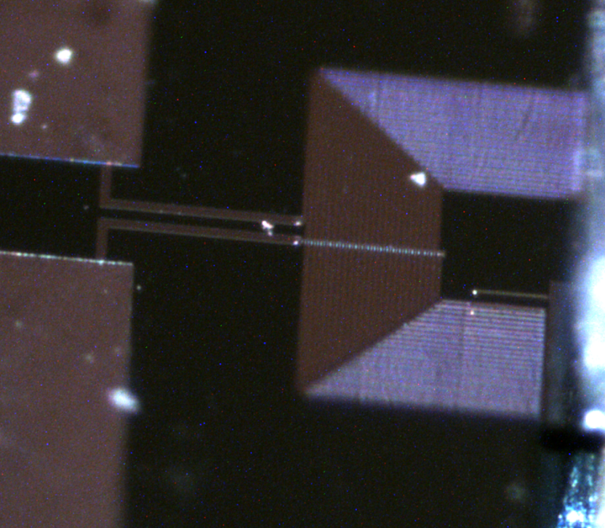
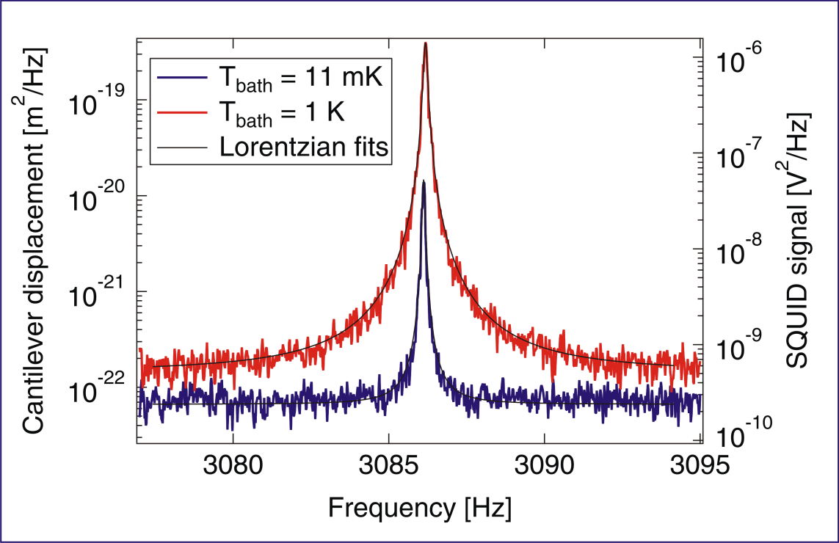
Cantilever thermal motion down to 25 mK
-multiturn detection coil
-static, horizontal cantilever
displacement sensitivity: 8 pm/sqrtHz
lowest force noise: 0.5 aN/sqrtHz
Usenko et al., APL 98 (2011)
Notes:
mention that this is measured with a static cantilever
context: way to measure performance of detection system: measure thermal excitation

Slide 11
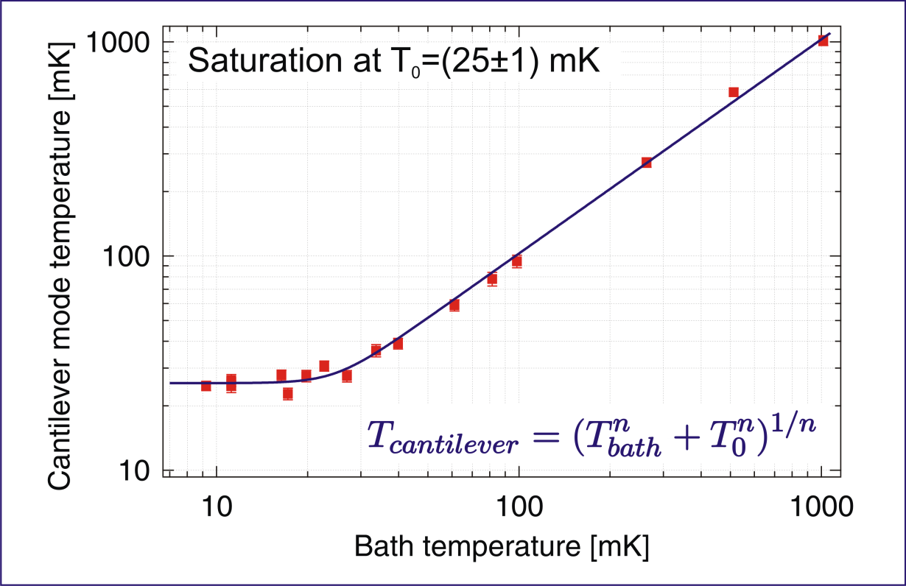
Cantilever thermal motion down to 25 mK
displacement sensitivity: 8 pm/sqrtHz
lowest force noise: 0.5 aN/sqrtHz
Usenko et al., APL 98 (2011)
Notes:
mention that this is measured with a static cantilever
context: way to measure performance of detection system: measure thermal excitation

Slide 12
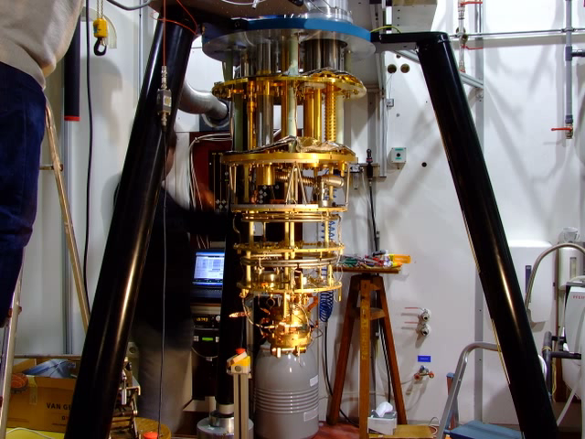


Slide 13
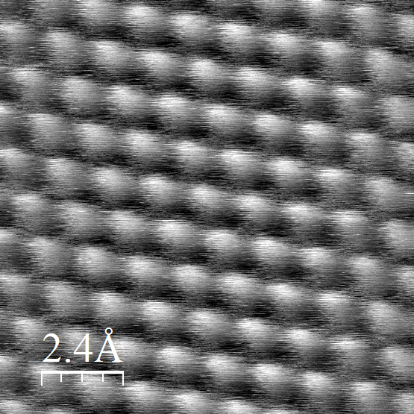
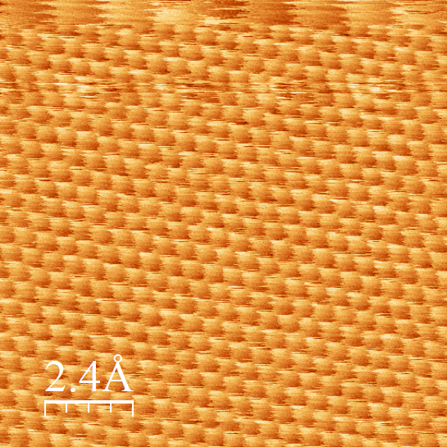
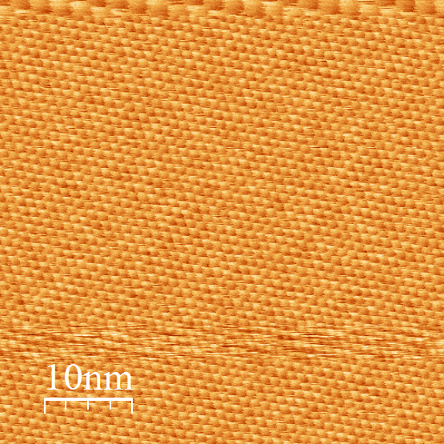
Atomic resolution
in STM,
despite compressor

Slide 14
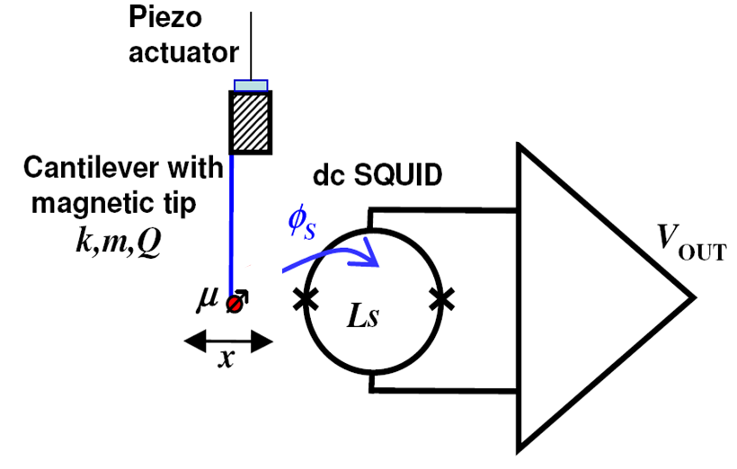
How to increase coupling : measure directly with SQUID (no intermediate pick-up coil)
Maximum coupling
close to the SQUID
High coupling using a small SQUID loop and tuning to optimal position.
Extremely high coupling if magnetic particle size is matched to SQUID size!
Problem: integration in the MRFM experiment is tricky.
Need for a highly balanced circuit to suppress direct SQUID-detection of rf B₁ field used for MRI.

Slide 15
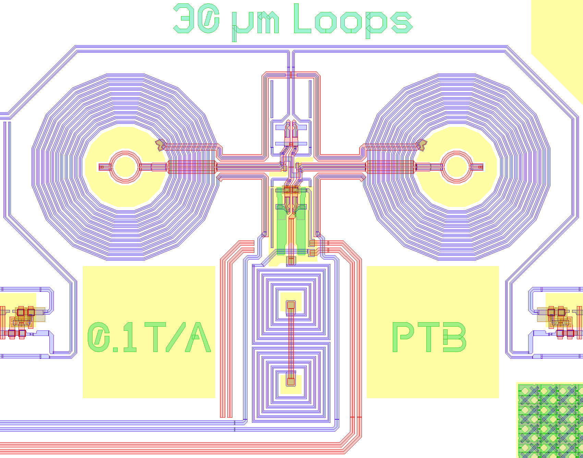
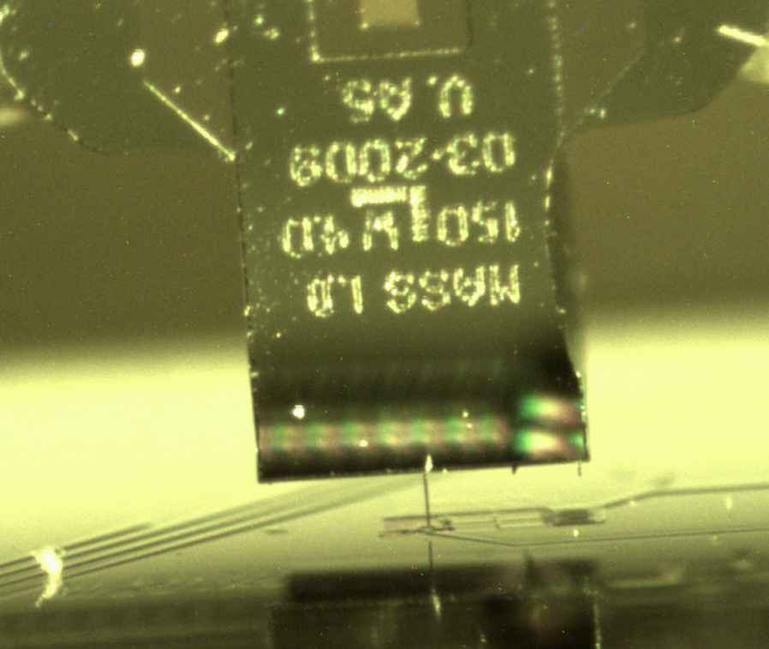
Experiment
Cantilever (IBM type)
on a 3D coarse approach
k=1x10⁻⁴ N/m
Q≈30000 @lowT
f0=4150 Hz
SQUID microsusceptometer
(T. Schurig and A. Kirste, PTB Berlin)
Loop diameter: 30 μm
Flux noise≈1 μφ₀/Hz^{1/2}

Slide 16
Experiment
Cantilever (IBM type)
on a 3D coarse approach
k=1x10⁻⁴ N/m
Q≈30000 @lowT
f0=4150 Hz
SQUID microsusceptometer
(T. Schurig and A. Kirste, PTB Berlin)
Loop diameter: 30 μm
Flux noise≈1 μφ₀/Hz^{1/2}

Slide 17
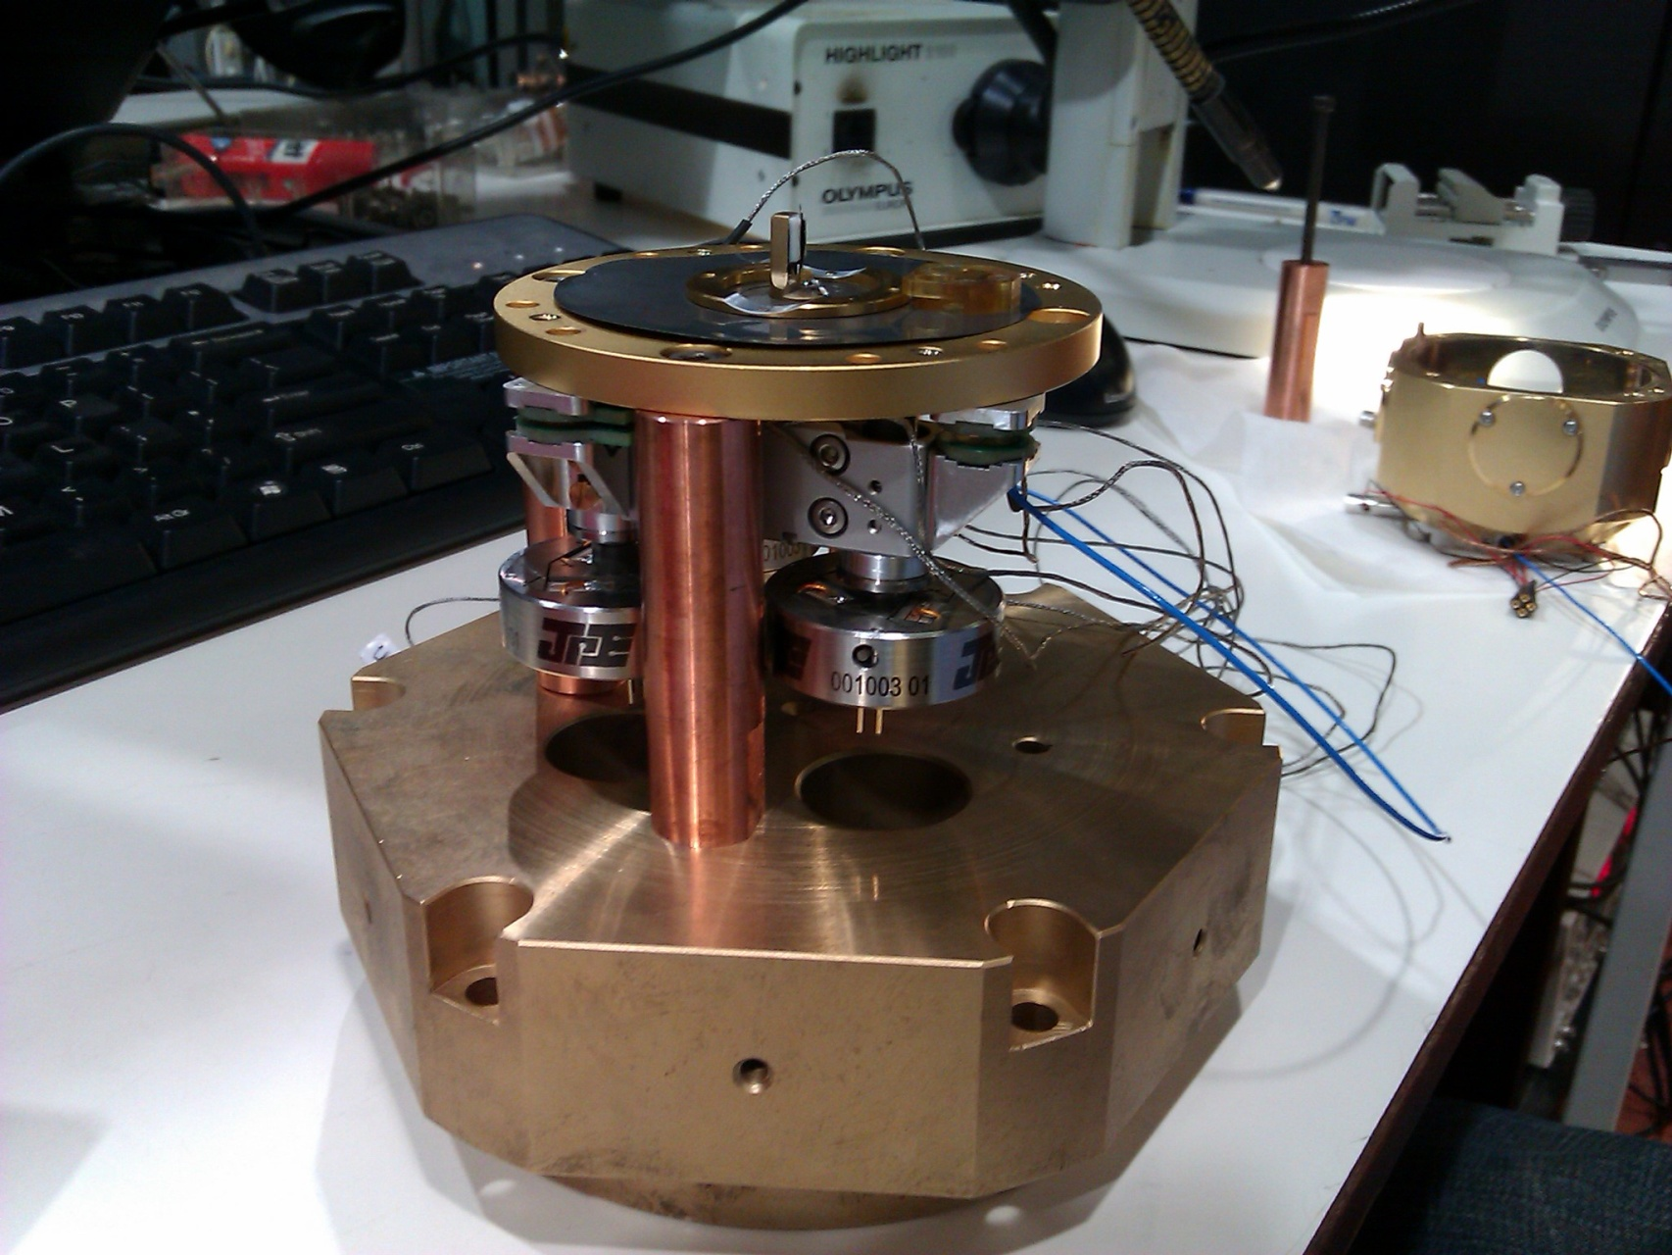
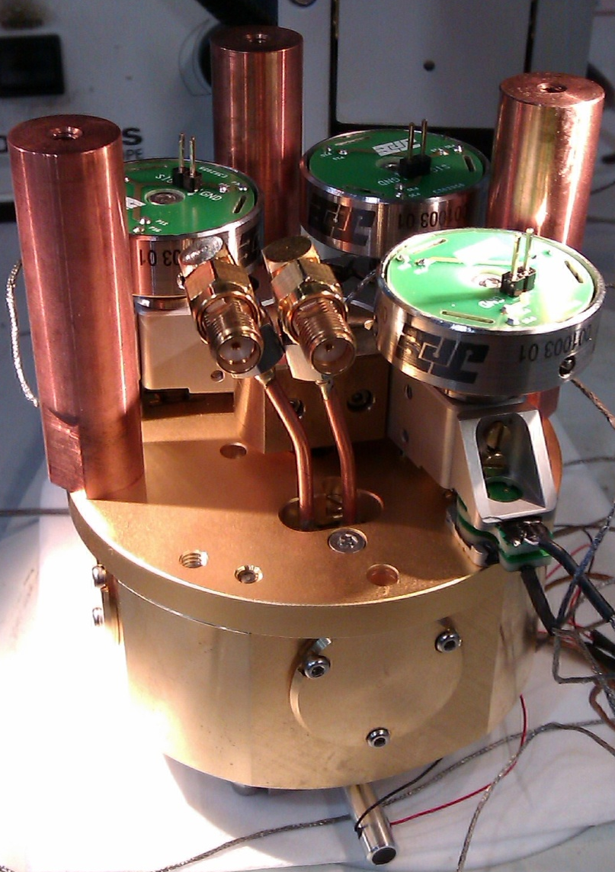
3D coarse alignment
3 piezo-driven screws

Slide 18
Detecting thermal motion at T=90 mK
Old setup: 200 μm pick-up coil + SQUID
5 μm magnetic particle
Direct detection with
a 30 μm SQUID
3 μm magnetic particle
Δf=2 Hz
Δf=200 Hz
Usenko et al, APL 2011
Notes:
18

Slide 19
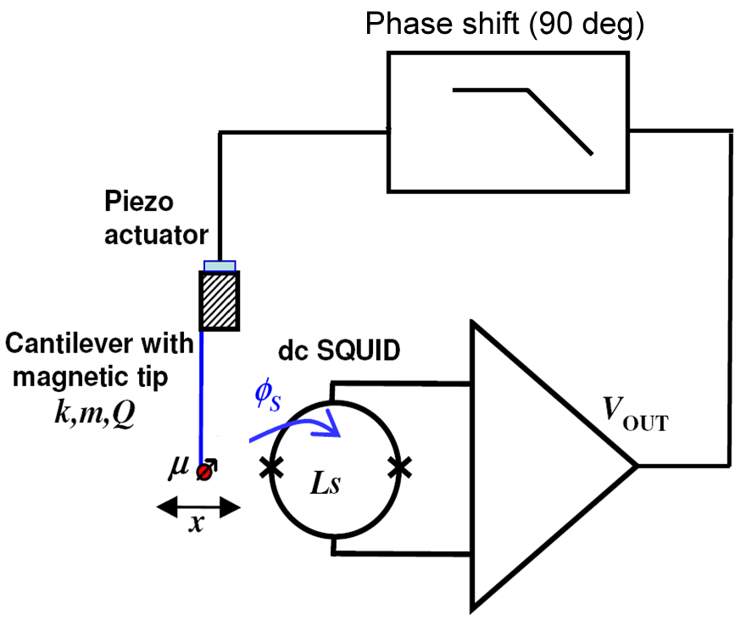
Feedback “cooling”
Negative feedback force ∝ velocity
Feedback-induced damping reduces effective Q factor

Slide 20
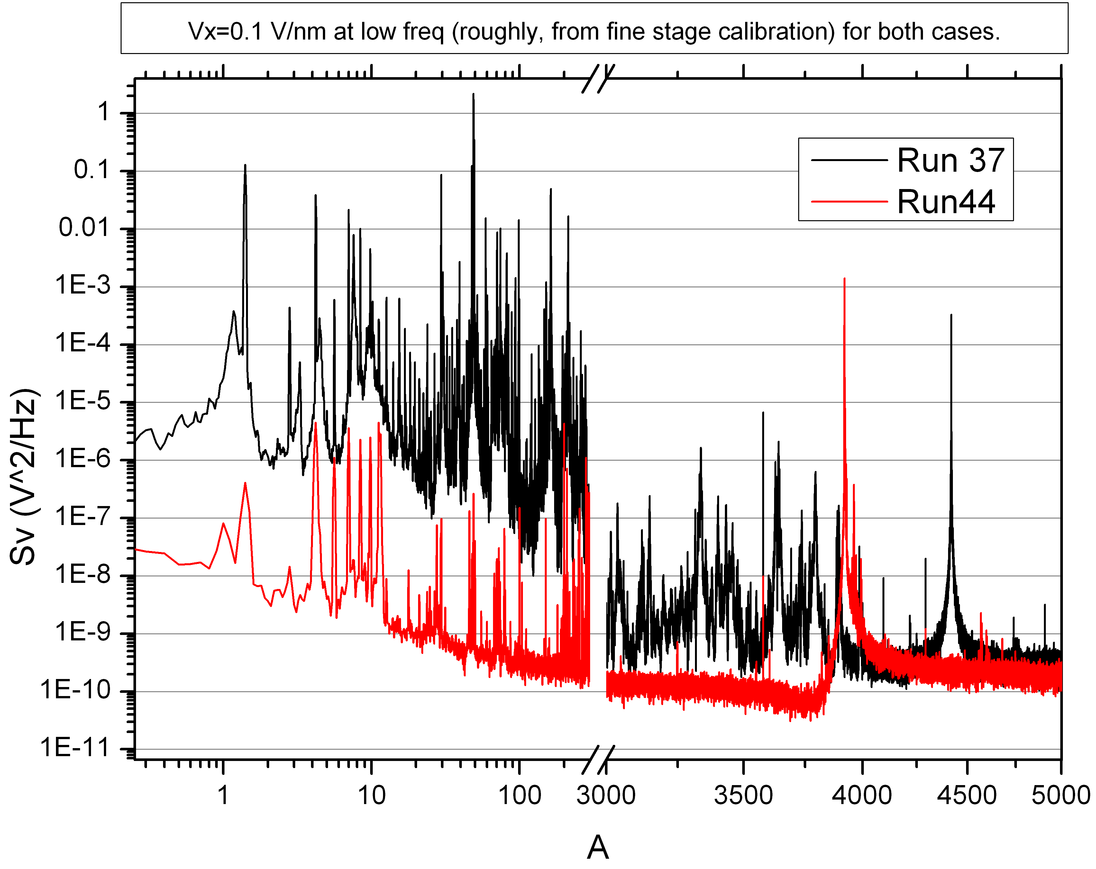
Good coupling to SQUID allows calibration of relative tip sample motion: 30 pm_{rms} total

Slide 21
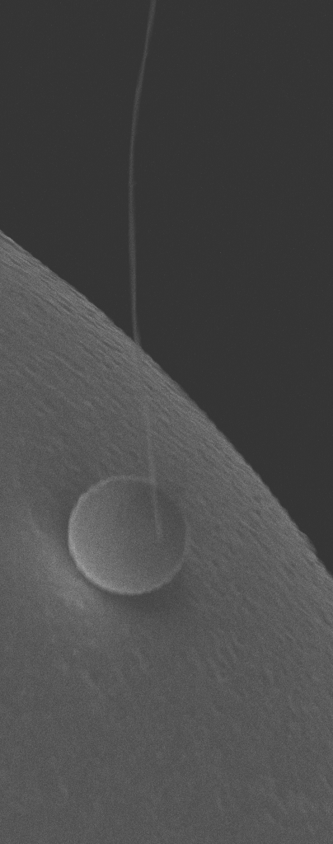
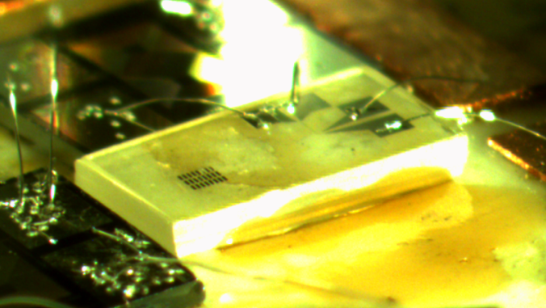
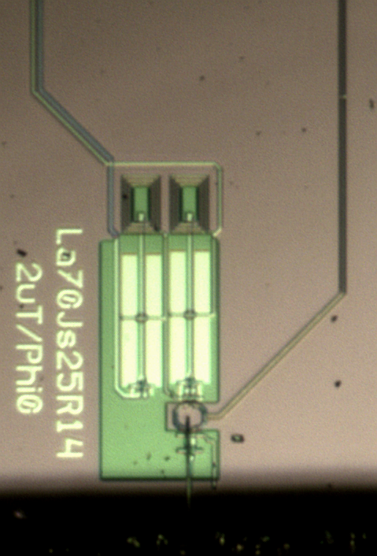
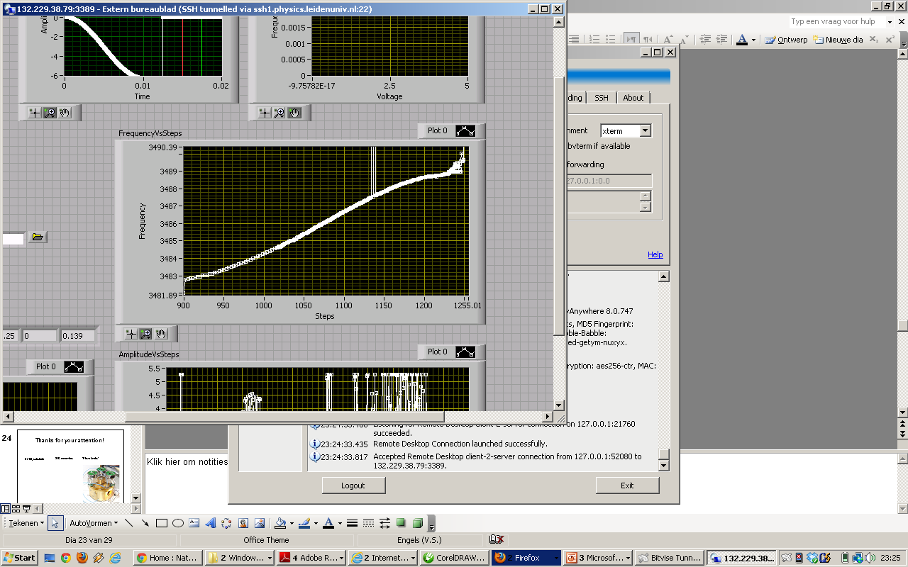
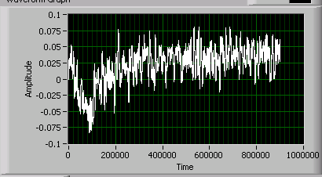
Higher coupling, 3D coarse approach, alternative cantilevers and substrates…
Cantilever directly above PTB SQUID*
“Piezo knobs”
SiC nanowires
SrTiO₃ substrate
sensitivity:
200 fm/√Hz
*Alexander Kirste
Physikalisch-Technische Bundesanstalt
Notes:
Do not explain the piezo knobs

Slide 22
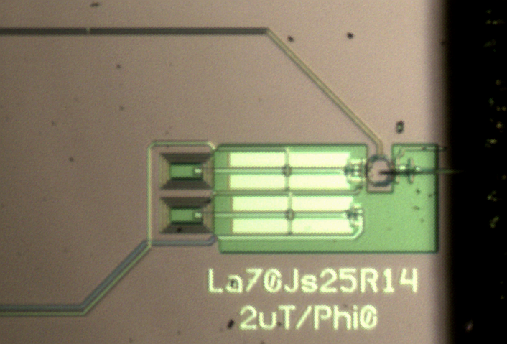
Works better for increasing displacement sensitivity
Cantilever directly above PTB SQUID*
Energy Coupling :=
Feedback Cooling (optimal controller)
T₀= 90 mK (no feedback)
T ≈ 150 μK (< 800 phonons)
Displacement noise floor ≈ 200 fm/√Hz
*Alexander Kirste
Physikalisch-Technische Bundesanstalt
Notes:
Merge with next slide, move this to questions.

Slide 23
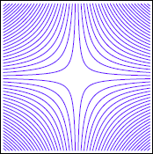
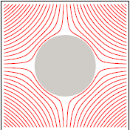






The Lead Zeppelin
drive
SQUID
Placing two circular loops carrying a current in an anti-Helmholtz configuration creates a magnetic potential well.
A superconducting sphere placed inbetween forms a resonator whose spring constant scales as.
O. Romero-Isart et al., “Quantum Magnetomechanics with Levitating Superconducting Microspheres”, 2011. arXiv: 1112.5609

Slide 24
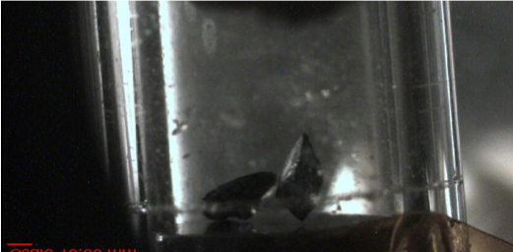
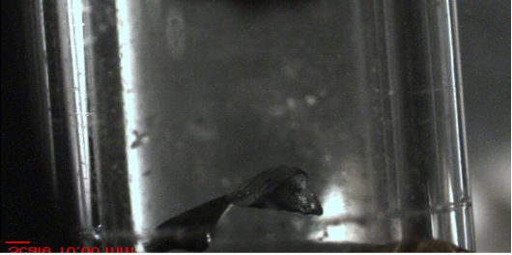

Slide 25
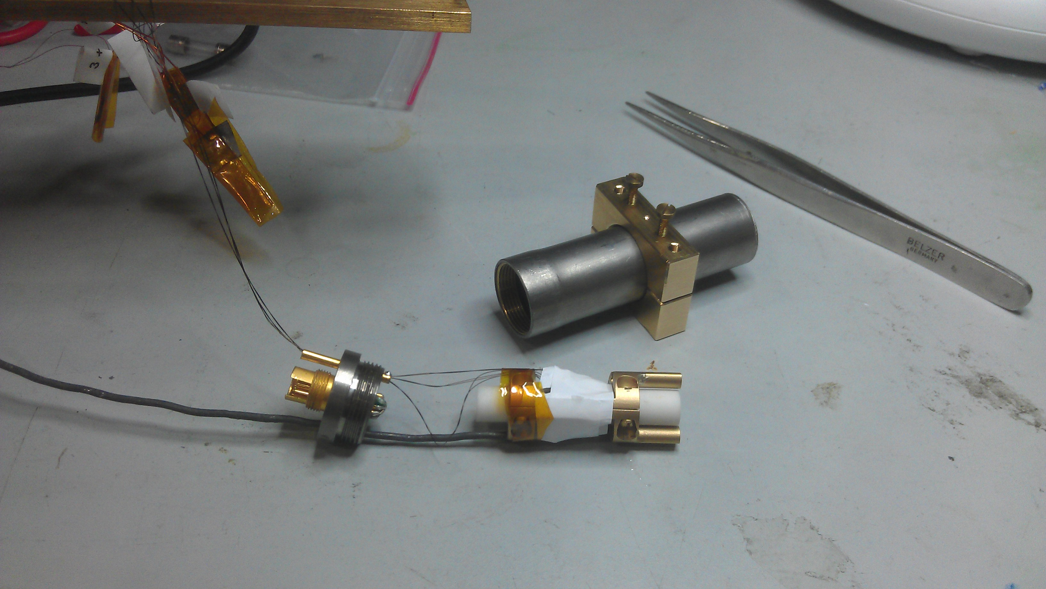
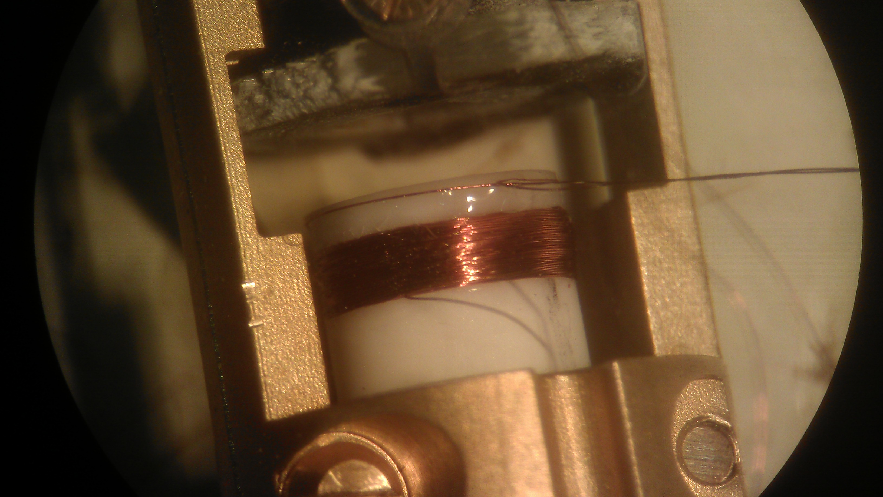

Slide 26
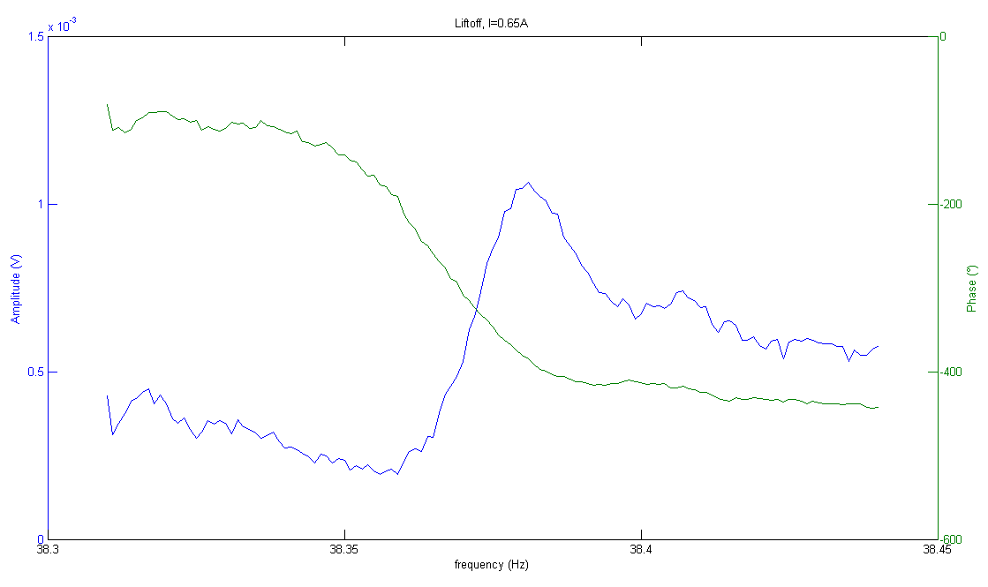
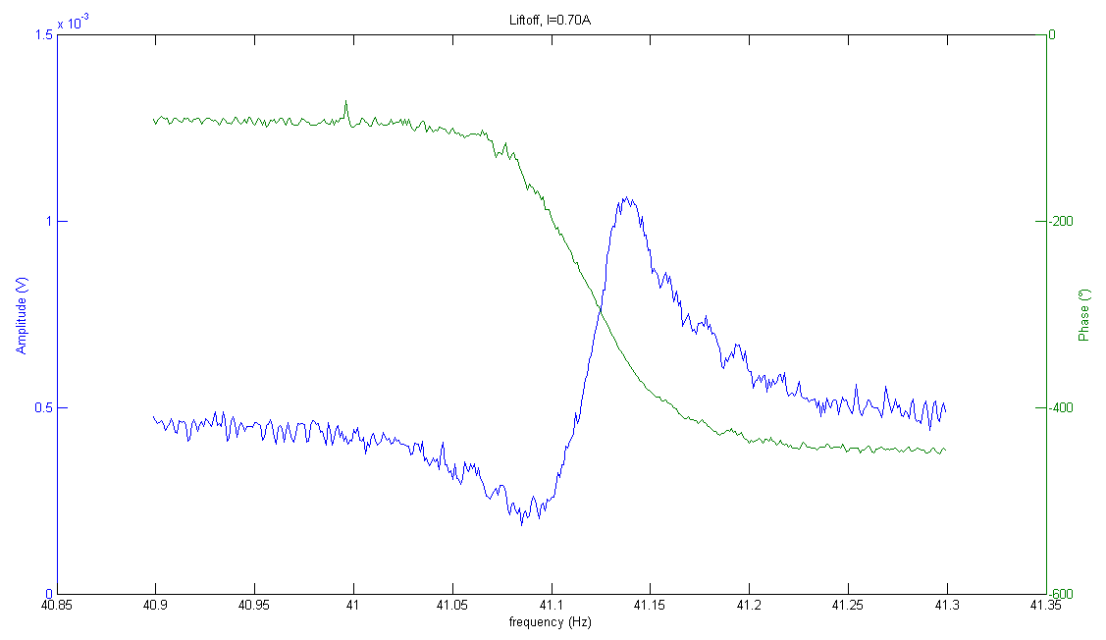
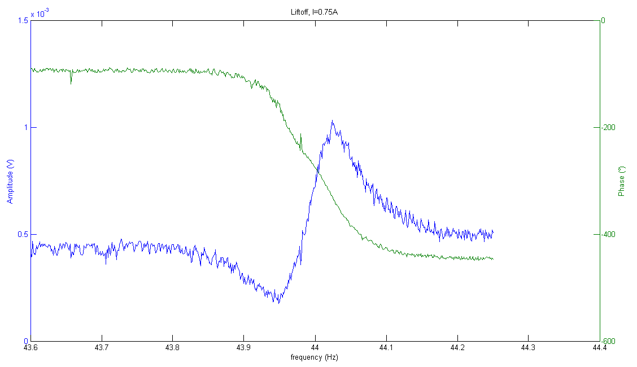




Slide 27








Slide 28



Slide 29
Why all this trouble: MRI-AFM?
I am puzzled by quantum mechanics
|ψ> = | > + | >

Slide 30
I am puzzled by quantum mechanics
|ψ> = | > + | >
|ψ> = | > + | >

Slide 31

Quantum Mechanics:
Electrons are particles and waves
Electron excites one pixel on the camera simultaneously(particles)
Electron behavior is that of a wave
Notes:
Een electron raakt één pixel tegelijk op de camera, zoals een deeltje dat zou doen. Maar de kans dat hij ergens terecht komt wordt beschreven door een golfvergelijking

Slide 32

A meaningful way to look at
Quantum State Reduction?
Jasper van Wezel
Jan Zaanen
Koenraad Schalm
Roger Penrose
Marc de Voogd
Dirk Bouwmeester
J. van Wezel, THO
Proc. Royal Society A, 2011
arXiv:0912.3675v2
Notes:
A proposed experiment to measure gravity's role in breaking the unitarity of quantum dynamics
Using nanomechanical devices, spatial superpositions can be created that are much more massive than those in interference experiments employing electrons, atoms or C60 molecules. We propose a combination of experiments on NV-centers and experiments employing mechanical resonators to detect single electron spins. This may allow the creation of a superposition of states, which will place a massive resonator in a superposition of two states, which are spatially separated by several nanometers.
With such an experiment one may begin to experimentally access the quantum to classical crossover, which will force us to consider the possible ways in which the usual quantum dynamics may be affected, for example through gravitational effects.

Slide 33
Outline
Penrose
Local clocks vWezel - Schrödinger
Noise
A possible experiment
J. van Wezel, THO
Proc. Royal Society A, 2011
arXiv:0912.3675v2
Notes:
A proposed experiment to measure gravity's role in breaking the unitarity of quantum dynamics
Using nanomechanical devices, spatial superpositions can be created that are much more massive than those in interference experiments employing electrons, atoms or C60 molecules. We propose a combination of experiments on NV-centers and experiments employing mechanical resonators to detect single electron spins. This may allow the creation of a superposition of states, which will place a massive resonator in a superposition of two states, which are spatially separated by several nanometers.
With such an experiment one may begin to experimentally access the quantum to classical crossover, which will force us to consider the possible ways in which the usual quantum dynamics may be affected, for example through gravitational effects.

Slide 34


Slide 35


Slide 36


Slide 37


Slide 38

Penrose:
Gravitational
Self Energy
Notes:
How to steal Roger’s overhead transparencies

Slide 39



Penrose:
1
G
1
G
1
G

Slide 40
Penrose:
a micrometer sized object,
with the density of water,
displaced over a micrometer
M²G/a ≈ 10⁻¹⁵ 10⁻¹⁵ 10⁻¹⁰/10⁻⁶ ≈ 10⁻³⁴ J
would collapse in a few seconds

Slide 41
Penrose:
a micrometer sized object,
with the density of water,
displaced over a nanometer
M²G/a * 2λ²
≈ a million times smaller
it would collapse in a few
million seconds

Slide 42

Where does this energy come from?
Why this integral?
Clock
Gravitational potential
Shapiro delay
Time evolution

Slide 43

Clocks
a)
b)
c)
Shapiro
delay
a
L
b
single
pulse
single
pulse
single
pulse
train of
pulses
train of
pulses
train of
pulses

Slide 44


Shapiro delay
From: Epstein explains Einstein

Slide 45


Not the same as gravitational lensing, but almost
30 minute journey,
200 microsec delay

Slide 46
Starting out with a toy clock model
Φ(r)
Φ_{a}
Φ_{b}
a
b
r

Slide 47





The ‘clock with the mass’ deviates ever so slightly from the ‘clock without a mass’
So, why care?

Slide 48


The two states of the sphere have different clocks

Slide 49

There is a surprise:
The absolute energy scale of E₁ and E₂ matters.
If you add an offset ΔE to both E₁ and E₂, φ increases

Slide 50


We choose to add an offset of Mc²
and calculate after how much time φ ≈ 1
v

Slide 51

… and perhaps not to our surprise….
c)
a
b
… the c² term drops out
and it becomes very similar to the Penrose Ansatz
single
pulse
train of
pulses

Slide 52
… but not completely the same
c)
a
b
single
pulse
train of
pulses

Slide 53
There’s an arbitrariness to the clocks…
all these clocks have a different
‘time difference’
and a displaced sphere wouldn’t
always show an effect
a
b
a
b
single
pulse
… how about giving every atom
in the sphere their own clock?
train of
pulses

Slide 54
Local clocks:
Φ(r)
Φ_{a}
Φ_{b}
a
b
r

Slide 55
Local clocks:
Φ(r)
Φ_{a}
Φ_{b}
a
b
r

Slide 56



One clock for the entire sphere:
one clock for one volume element
If the effect works cumulatively:
Penrose:

Slide 57
a
b
a
b
single
pulse
train of
pulses

Slide 58
Outline
Penrose
Local clocks vWezel - Schrödinger
Noise
A possible experiment
J. van Wezel, THO
Proc. Royal Society A, 2011
arXiv:0912.3675v2
Notes:
A proposed experiment to measure gravity's role in breaking the unitarity of quantum dynamics
Using nanomechanical devices, spatial superpositions can be created that are much more massive than those in interference experiments employing electrons, atoms or C60 molecules. We propose a combination of experiments on NV-centers and experiments employing mechanical resonators to detect single electron spins. This may allow the creation of a superposition of states, which will place a massive resonator in a superposition of two states, which are spatially separated by several nanometers.
With such an experiment one may begin to experimentally access the quantum to classical crossover, which will force us to consider the possible ways in which the usual quantum dynamics may be affected, for example through gravitational effects.

Slide 59


Slide 60


Slide 61


Slide 62


Slide 63


Slide 64


Slide 65


Slide 66


Slide 67

A possible experiment

Slide 68


Slide 69

NV centers in diamond (R. Hanson, Delft)

Slide 70


What is measured in NV centers?
B. Meier, …, Wrachtrup

Slide 71

NV-electron spin T₂ ~ 2 msec
(freeze out other electron spins, reduce ¹³C)
Wrachtrup

Slide 72
Prepare the electron spin in its ground state
Superposition: π/2 pulse
π pulses to drive the resonator to quite a large amplitude
Detect electron spin state
NV-electron spin already has coherence time of ~ 2 msec
At T<100 μK, N_{phonons} is small
τ_{coh} ~ Q_{cant}/f_{cant}*1/N_{phonons}

Slide 73
Conclusion
The consequence of a successful gravitational collapse experiment might be that when unitarity comes to an end, the rest mass of Schrödinger's cat is no longer a quantity that can be gauged away.

Slide 74
Acknowledgements:
Leiden
Geert Wijts
Sasha Usenko
Andrea Vinante
Bob van Waarde IBM
Arthur den Haan Dan Rugar
Marc de Voogd John Mamin
Jelmer Wagenaar
Technicians Companies $$$
Marcel Hesselberth Leiden Cryogenics MicroKelvin
Dian van der Zalm Leiden Probe Micr STW
Gert Koning Jansen Precision Eng ERC StG/PoC
Raymond Koehler Leiden Spin Imaging NWO
Bert Crama FOM
Petro Sonin
Evan Jeffrey
Dirk Bouwmeester

